Slide 1
Website Navigation
Illustrates the navigational steps, necessary as of mid 2003, to locate historical household income data from the U.S. Census Bureau Web site

Slide 2
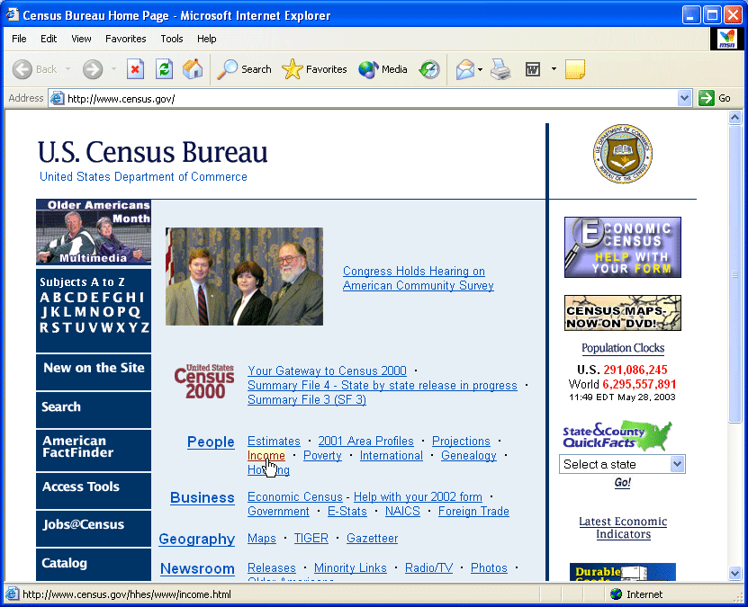
Step 1: Retrieve Census Bureau home page
Ready to click Income link

Slide 3
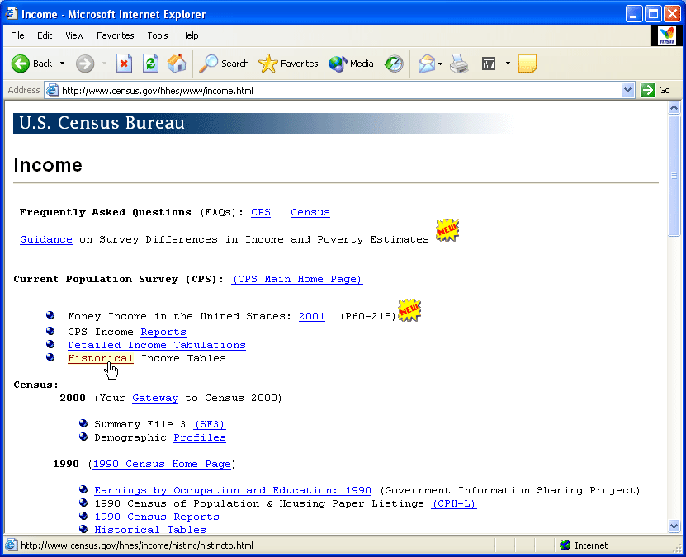
Step 2: Census Bureau Income page
Ready to click Historical Income Tables link

Slide 4
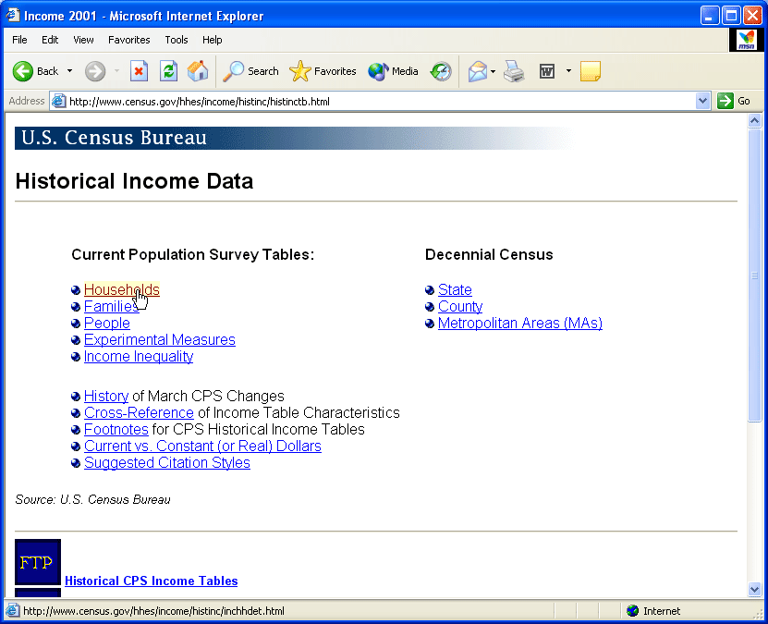
Step 3: Historical Income Tables page
Ready to click Households link

Slide 5
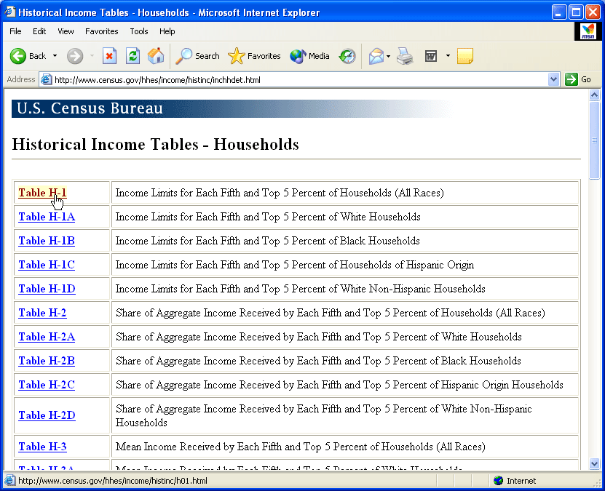
Step 4: Households Income Tables page
Ready to click Table H-1

Slide 6
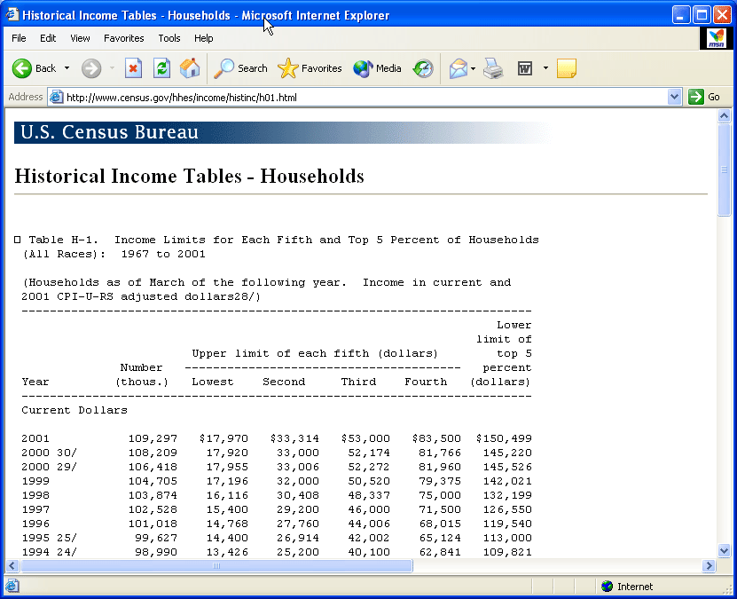
Step 5: Table H-1 data page
Households data

